Slide 1
Classic ASP (VBScript)
A Brief Introduction

Slide 2
Classic ASP – What is it?
ASP (Active Server Pages)
  ASP is a server side technology. It enables computer code to be executed by an Internet server.
  When a browser requests an ASP file, the ASP engine on the server reads the file, executes any code in the file, and returns the resulting response to the clients browser.
  ASP is commonly written in the VBScript language, which is what we are going to cover today.

Slide 3
How To Write ASP
ASP can be embedded within standard HTML
ASP code needs to be encased with <% ……… %>
Response.write is used to write out a response to the screen
  Response.write “<p>Write Me</p>”
Response.write can also be written short hand using <%= to open.
  <%= “<p>Write Me</p>” %>

Slide 4
Variables
Data, Data, Data

Slide 5
Variables
Variables are essentially data stores within code. They store the value to an assigned name which can then be used/reused/modified throughout the code.
They are useful when dealing with repetitive processes where the variable can change with each repetition.
Variables can hold a single piece of data or be combined into Arrays

Slide 6
Arrays
Arrays are used to store multiple values usually around the same subject.
Arrays are accessed via their index or position. Indexes in ASP begin at 0.
You have to declare the size of the array as below. As indexes start at 0 the size of the array needed is Total – 1
Dim days(6)
Days(0) = “Monday”
Days(1) = “Tuesday”
Days(2) = “Wednesday”
……

Slide 7
Objects – SET Keyword
Objects in ASP, come in the form of Classes or ASP Plugins to enable certain functions.
Declaring an Object required the SET keyword to be used.
DIM myObject
SET myObejct = New MyObject
DIM myObject : SET myObject = New MyObject

Slide 8
Dictionary
The Dictionary Object is a special type of array within ASP
Dictionaries use Key = Value system instead of indexes
To access the value you need to specify the key in the object.
Dim dictDays : Set dictDays = Server.CreateObject(“Scripting.Dictionary”)
dictDays.add “Monday”, 0
dictDays.add “Tuesday”, 1
……
response.write dictDays(“Monday”) <- outputs 0

Slide 9
Variable scope
Variables within classes should use either Public or Private.
  Public means that the variable or method can be accessed externally via objClass.myMethod() or objClass.myVar
  Private means that the variable or method can only be accessed within the class itself.
Variables within methods should be declared with DIM, PRIVATE or PUBLIC. This makes the variable only usable within the method. If this is not included then if a global name is in use this will overwrite the value when used.
  Dim – Local only Variable
  Private – Can only be used with the current instance of the class
  Public – Can be used anywhere within the execution

Slide 10
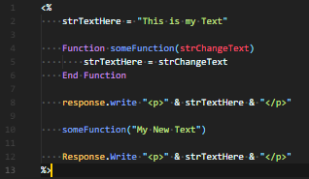
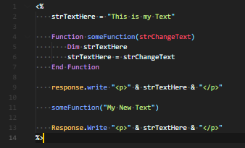
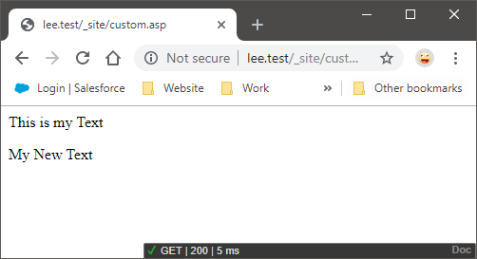
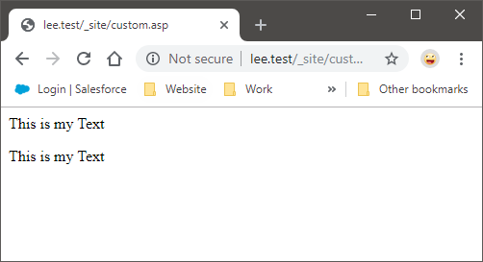
Variable Scope - DIM

Slide 11
Variable Scope
Private
  Where classes are used, the private keyword means that the variable can only be used within the class and is not accessible outside the class code without the use of a public get or set method.
Class Test
Private testVariable
Function someFunction()
someFuncton = testVariable
End Function
End Class
testClass = new Test
testClass.testVariable <- Fails as the variable is private
testClass.someFunction() <- Succeeds as the variables is accessed within class method

Slide 12
Variable Scope
Public
  Where classes are used, the public keyword means that the variable can be accessed via the instance of the class variable using the DOT notation.
Class Test
Public testVariable
Function someFunction()
someFuncton = testVariable
End Function
End Class
testClass = new Test
testClass.testVariable <- Succeeds as the variable access is public
testClass.someFunction() <- Succeeds as the variables is accessed within class method

Slide 13
Variable Types
Variables in ASP are typeless or loosely-typed, meaning that you do not have to define what type the variable will contain as you do with some programming languages

Slide 14
Script, Session & Application Variables
Variables can be stored in one of 3 ways.
  Script
    Script variables live as long as the script is being run. Once the script completes execution the stored variable is removed
  Session
    Session Variables are used to store information about one single user. These can be used for preference based values such as High-Visibility or Baskets
  Application
    Applications Variables are applicable to all pages within the application for every user of the website.

Slide 15
Code Structures
How it all fits together

Slide 16
Flow Control Structures
Flow Control Structures determine how code is executed. They are split into 2 categories:
  Conditionals
    These are used to toggle whether a code operation is carried out or not based on the result of a comparison.
  Loops
    These are used to iterate the same code operation over again until a terminating condition.
Flow control structures can also be nested in each other.

Slide 17
Conditionals
What IF? Whatever…

Slide 18
ConditionALs
IF – THEN
  If-Then is used to check if an operation should be completed or not
  If tea.fillLevel = 0 Then
  makeTea()
  End If

Slide 19
ConditionALs
IF – THEN - ELSE
  If-Then-Else is used to check if an operation should be completed. If not then another code block should be executed
  If tea.fillLevel = 0 Then
  makeTea()
  Else
  drinkTea()
  End If

Slide 20
Conditionals
IF – THEN – ELSE IF – ELSE
If-then-elseif-else is used to check multiple conditions in an order. If the first one passes the check code is executed and the If statement is exited.
If blnLikeTea = true Then
  makeTea()
Else If blnLikeCoffee = true Then
  makeCoffee()
Else
  makeSquash()
End If

Slide 21
Boolean LOGIC
Boolean Logic allows conditions to be concatenated into one statement using a series of Operators
AND – All conditions must be true
OR – Only one condition must be true
The inverse operator NOT can also be used to negate the value.
AND and OR can also be used in the same IF statement but require brackets to be used for the logic to equate correctly

Slide 22
Boolean Logic
IF tea.fillLevel = 0 AND me.isThirsty = true Then
  makeTea()
IF tea.fillLevel = 0 OR tea.temp < 40 Then
  makeTea()
IF NOT tea.fillLevel = 0 AND tea.temp < 40 Then
  makeTea()

Slide 23
Conditionals
Select-Case
  The Select-Case conditional allows for the condition to evaluate multiple expected values or use a default.
Select weekday
Case 1
“Monday”
Case 2
“Tuesday”
Case …
Default
“Some Day of the Week”

Slide 24
Loops
They just Go On and On and ON

Slide 25
Loops
Loops can come in a few different forms. Their job is to iterate over the same code multiple times, usually using different values during the operation.
They are commonly used to loop through arrays.
Common Types of loop are:
  For (inc Step)
  Foreach
  Do While/Until Loop

Slide 26
FOR
For loops allow a specified number of iterations.
For i = 0 to 10
response.write i & “,”
Next
The step keyword can be used to jump that number in this case
For i = 0 to 10 step 2
response.write i & “,”
Next
Output: 0,1,2,3,4,5,6,7,8,9,10,
Output:0,2,4,6,8,10,

Slide 27
For with Arrays
Arrays can also be traversed with a for loop using the index and the size of the array as the for instantiation values. The Ubound() method is used to find the Upper Bound of the array.
DIM arrDays(6)
arrDays(0) = "Monday"
arrDays(1) = "Tuesday"
arrDays(2) = "Wednesday"
…
For i = 0 to UBound(arrDays)
response.write i & " = " & arrDays(i) & "<br/>"
Next

Slide 28
FOR EACH
The for each loop allows for the iteration through a collection such as the dictionary object (Key = Value).
DIM dictDays : SET dictDays = Server.CreateObject(“Scripting.Dictionary”)
dictDays(“Monday”) = 0
dictDays(“Tuesday”) = 1
dictDays(“Wednesday”) = 2
…
For each strDay in dictDays
  response.write strDay & “ = “ & dictDays(strDay) & “<br/>”
Next
OUTPUT:
Monday = 0
Tuesday = 1
Wednesday = 2
…

Slide 29
DO
Another looping method is the DO loop
Do loops differ from For loops as the length of time for it to execute can be infinite without the correct terminating condition.
Do loops are used when the execution length is unknown when creating the loop
Terminating conditions can vary between WHILE and UNTIL
Boolean Login can also be used with While and Until

Slide 30
DO WHILE
The DO WHILE loop will continue to execute whilst the condition is true.
DO WHILE i < 10
  response.write i & “,”
  i = i + 1
LOOP

Slide 31
Do UNTIL
The UNTIL clause will execute until the condition becomes true
DO UNTIL i = 10
  response.write i & “,”
  i = i + 1
LOOP

Slide 32
WHILE and UNTIL Position
The While and Until clauses can come before or after the loop declaration. If the loop is before the condition is checked first, whereas after the loop will execute once before the condition is checked
i = 1
DO WHILE i < 1
response.write i & “,”
i = i + 1
LOOP
This will not output anything
i = 1
DO
response.write i & “,”
i = i + 1
LOOP WHILE i < 1
This will output 1, because the loop is executed once before the condition is checked

Slide 33
What’s WRONG HERE?
i = 1
DO WHILE i < 10
  Response.write i & “=“
LOOP
This loop is missing the incrementation inside the loop. i can never increase and will always be 1.
WARNING – BE VERY CAREFUL WITH DO LOOPS, YOU CAN CAUSE AN INFITITE LOOP WHICH WILL CAUSE THE SITE TO NOT RESPOND

Slide 34
EXITING LOOPS EARLY
Sometimes it is necessary to exit a loop earlier than the conditions set require it to. For example, if an error or desired outcome occurs in the middle of the loop.
Loops can be exited using the EXIT keyword, along with the loop type.
EXIT FOR
EXIT DO

Slide 35
Exiting LOOPS EARLY
FOR I = 0 to 20
  IF I = 10 Then
    EXIT FOR
  END IF
NEXT
DO WHILE i < 20
  IF i = 10 Then
    EXIT DO
  END IF
  i = i + 1
LOOP

Slide 36
Functions & SUBS
Functions are snippets of code which can be called multiple times during execution. This helps to prevent repetition of code hopefully making the software more efficient.
Functions & Subs can either have no parameters or multiple parameters.
Functions have a return value
Subs have no return value

Slide 37
Functions
Functions which have a return value use the Function keyword to declare the function. To end the functions code use End Function.
To return the value, you assign the value to the name of the function within the functions code.
Functions require brackets to call parameters
strValue = myFunction(1,2)
Function myFunction(param1, param2)
  Some code…
  myFunction = strVariable
End Function

Slide 38
SUBs
Subs or subroutine is a type of function but doesn’t have a return value. Parameters can still be passed. This is to perform operations on code but doesn’t need to return the value back.
mySub 1, 2
Sub mySub (param1, param2)
  SomeCode…
End sub

Slide 39
Parameters - ByVal or ByRef
When parameters are passed, the function declaration can use either BYVAL or BYREF to determine how the data is passed to the function
BYVAL is used to pass the value of the variable into the function
BYREF is used to pass the reference to the variable into the function
If neither is declared explicitly BYVAL is used as the default

Slide 40
Useful Information
https://www.w3schools.com/asp/
StackOverflow

