Slide 1
E4education CMS 4.5
How it Works – Technical Overview

Slide 2
Before we begin…
Before starting we should go over some terms used in this presentation…
ASP (Active Server Pages)
  ASP is a server side technology. They enable computer code to be executed by an Internet server.
  When a browser requests an ASP file, the ASP engine reads the file, executes any code in the file, and returns the result to the browser.
JavaScript
  JavaScript is a client side scripting language that allows for creation of dynamically updating content, control multimedia, and other interactivity with a web page.
JQuery
  JQuery is JavaScript library which simplifies operations. Normally it would take multiple lines of standard JavaScript code to accomplish and combines them into a single operation.
CSS
  CSS is used to define styles for your web pages, including the design, layout and variations in display for different devices and screen sizes.

Slide 3
CMS Technologies
The CMS is mostly built in Classic ASP
JavaScript and JQuery provide the front end interaction for users
Classic ASP is a Server-Side Script Engine for dynamically created WebPages usually supported by a data source. XML, database, JSON or other data storage structures.
The programming language the ASP server-side code is written in is the VBScript language.

Slide 4
CMS FILE Structure
How it’s all structured

Slide 5
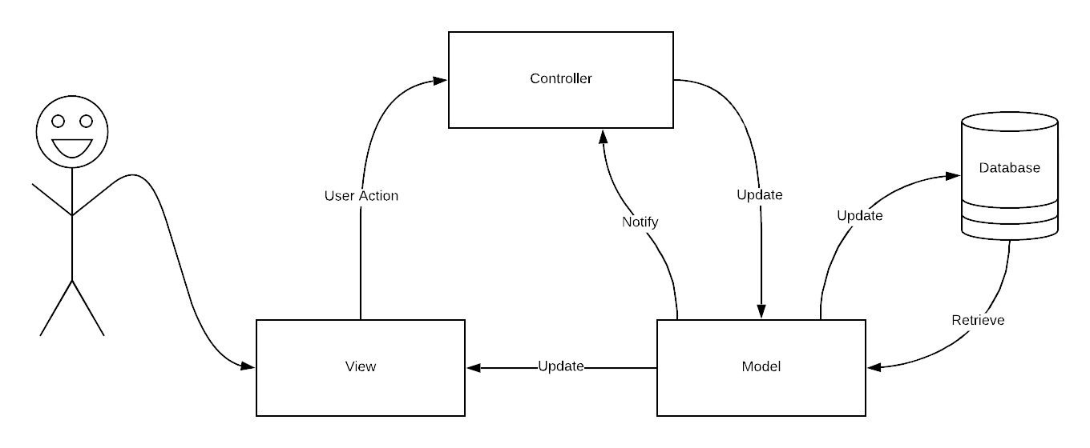
MVC
The CMS uses a basic MVC principle.
MVC stands for:
  Model – usually a class which holds or retrieves data from the database and performs logical operations on data
  View – this is the file which is responsible for the output of data from the model
  Controller – this is the file which is performs alterations and changes to the data

Slide 6
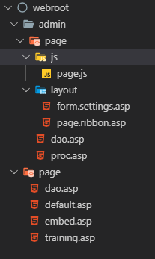


Basic Structure
admin
  page
    js
      page.js (Admin JavaScript Functions)
    layout
      form.settings.asp (Holds data to be submitted on save)
      page.ribbon.asp (Layout of buttons available below edit)
    proc.asp – (CONTROLLER)
    dao.asp – (MODEL – for admin operations)
page
  dao.asp (MODEL – for view operations)
  default.asp (VIEW)
  embed.asp (Used with the Link Type of Embed)
  training.asp (Used for WalkMe)

Slide 7
Classes
A Class is a custom object defined in ASP code. A class will usually have variables and functions which relate to the classes function. Classes are used extensively in the CMS. Classes are key to using a MVC design pattern.
Classes in the CMS are either dao.asp files in the itemtypes folder, or are denoted by the filename class.classname.asp
Classes are defined using the Class keyword.
Class Page
  private strVariables
  …
  public function getVariable()
    getVariable = strVariable
  End function
  …
End Class
Classes are then called and created using the SET and NEW keywords providing that the class asp file is included using <!-- #includes
Dim pageClass : SET pageClass = new Page

Slide 8
How Pages Fit Together

Slide 9
<!– #includes virtual
<!-- #includes virtual is a line of code which sits outside of ASP tags
All this does is to include the file into the codes execution. The ASP execution would see this as being a long page of code.
This allows additional ASP scripts to be included, this helps with organisation of files and the file structure.

Slide 10
Important Includes
Whilst all includes are essential for the CMS to work and function correctly, some files contents are key for finding out information about various settings and CMS functionality:
/_includes/code/common.asp
  This is probably the most important file. It includes all other files required for the CMS to work, including the dao class files for each of the item types.
  There are other settings in here which are useful for reference and include setups for Application variables which store how various elements for the site display, or if a specific item is switched on (i.e. connect)
/_includes/code/classes/class.mason.site.asp
  This file denotes setup for the current site. This has default settings for items. For example when we add the calendar print or subscribe options we use: Mason.site.setConf “calendar_ics”, true, this is the file where we are making the change to whether this outputs or not.

Slide 11
Includes (The Sites Design)
The includes code also shows how the sites design is applied into the CMS and makes each site unique in its appearance. Lets look at the /page/default.asp file which is the view file for any ‘page’ item type on the site.
This file includes the /_includes/layout/static/global.header_static.asp file which in turn includes the /_site/layout/page.head.asp and the /_site/layout/page.body.asp files

Slide 12
/*/dao.asp
The /page/dao.asp file along with majority of the other dao.asp files located in the top level of the CMS webroot folder are the methods which access the data to display it.
The data contained within the loaded object is accessed through the public variables set. For example the page body content is accessed using objPage.strItemBody
For non-page items there will generally be some display function which will use a template for repeated items such as news stories. This will be used for feeds on the website. These contain merge fields denoted by {item_name} which get replaced within the template as it is looped over the containing items

Slide 13
/admin/*/dao.asp
The /admin/*/dao.asp files are the files which process and write data to the database.
They include methods for creating, updating and deleting data from the database as requested from the proc.asp files.
The proc files handle the processing of the data and pass information to methods in the admin class file for the data to be stored in the database

Slide 14
Saving items in the CMS
General Overview

Slide 15
Saving Items – Step 1 (User Interaction)
When changes are made to the content area, when deselection of the edit area occurs, a JavaScript function executes to copy the HTML content generated by the CMS Editor into a form field used for save.
This also applies to custom fields, titles and other editable fields.
When the user saves the page, the contents of the form are submitted to a proc.asp file.

Slide 16
Saving Items – Step 2 (proc.asp)
The proc.asp file will check the contents of the data provided in the POST method to validate the types of data. This helps against SQL Injection before any data is processed and submitted to the database.
Checks are then made to check what operation is occurring.
  Save
    Publish – User saves the item directly to the website
    Draft – User saves the item as a draft
    Send for Approval – User saves the item as a draft and submits to a user for approval
  Delete
    Publish – User deletes the item and it is immediately deleted
    Send for Approval – User sends the deletion request for approval
Depending on the action requested checks are made against the users account permissions and the actions performed.

Slide 17
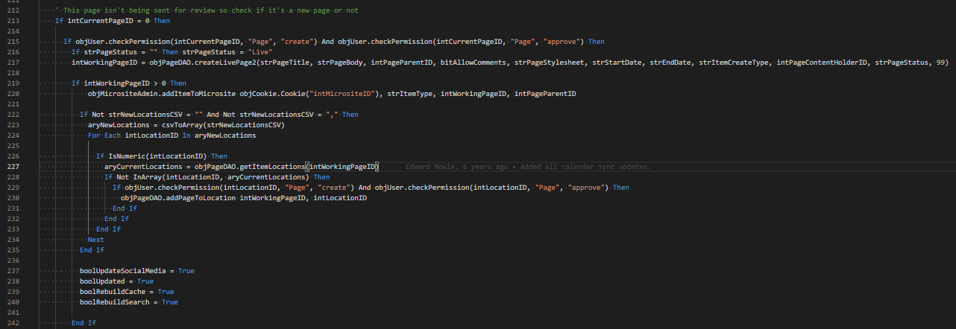
Saving Items – Step 3 (proc.asp)

Slide 18
Saving Items – Step 3 (proc.asp)
215 – Check Users Permission to create and approve
216 – Set page status to live if no status set
217 – Create the page through the PageAdmin Class
219 – Check the page was successfully created
220 – Add page to microsites structure
222 – Check if the page has additional locations
223 – converts locations CSV to array
224 – Loop through Page Location array
226 – Check if the location is a number
227 – Get Pages current locations
228 – Check if the location already exist
229 – Re-Check Permissions for the new location
230 – Add page to locations
237 – 240 – set that the item has been updated and that we need to rebuild the sites caches once the code execution completes

Slide 19
Proc → Storage Process
createLivePage -> createLivePage2 -> saveGenericPage
Data is then added into a dictionary object
  objPageData.Add “PageTitle”, strPageTitle
  First Parameter is the FieldName in the database
  Second is the value of the field to be added
Checks are made against the dates entered into the database for archive/go-live.
Checks if the reviewer is active, is so then set the status of the page to draft.
Add the pages status to the dictionary object
Submit the dictionary object to the database class.

Slide 20
CMS 4.5 ASP Coding Practices
HTML CSS Classes are generally single underlined when within the admin side of the website, and double underlined by FEDs. This is to distinguish between the two so styles don’t conflict with each other, we should remember this when making changes to sites.
Class Names
  Class name definitions usually indicate what their job is.
  i.e. ‘class Page’ is the page viewing class, where the ‘class PageAdmin’ is page modification admin class.

Slide 21
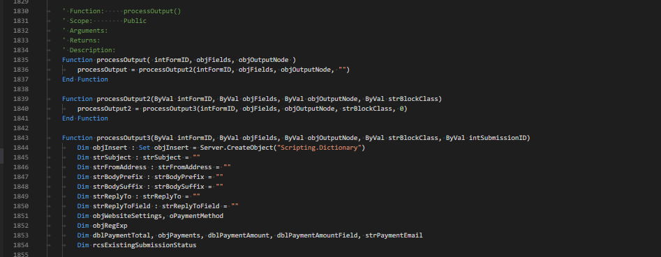
Overwritten Methods
Some methods in the CMS have their methods overwritten. ASP does not have the capability for method overloading. This is where the same method name exists with different numbers/types of parameters. So some methods will instead call another method as 1 line of code. This is to accommodate backwards compatibility with older site versions.

Slide 22
Variable Naming Conventions
Variable Naming
  Variable definitions usually start with their type prefix as ASP is a loosely-typed language. This is to make it easier for us to identify what type the variable should be
  Common Types
    str – String
    int – Integer
    lng – Long
    bool – Boolean
    obj – Object (a class)
    rcs – Recordset (Database results)
    bit – True/False

Slide 23
CMS Coding Practices
Variable conditionals should check Boolean values explicitly.
  if blnTrue then
  if blnTrue = true Then
  if blnTrue = “true” Then

Slide 24
What is the output? (1) - ASP
1| blnIsTrue = "true"
2| If blnIsTrue Then response.write "1"
3| If blnIsTrue = true Then response.write "2"
4| If blnIsTrue = "true" Then response.write "3"

Slide 25
What is the output? (2) - ASP
1| blnIsTrue = true
2| If blnIsTrue Then response.write "4"
3| If blnIsTrue = true Then response.write "5"
4| If blnIsTrue = "true" Then response.write "6"

Slide 26
What is the output? (3) - ASP
1| blnIsTrue = "false"
2| If blnIsTrue Then response.write "7"
3| If blnIsTrue = true Then response.write "8"
4| If blnIsTrue = "true" Then response.write "9“

Slide 27
What is the output? (4) - ASP
1| blnIsTrue = false
2| If blnIsTrue Then response.write "10"
3| If blnIsTrue = true Then response.write "11"
4| If blnIsTrue = "true" Then response.write "12"

Slide 28
What is the output? (5) - ASP
1| blnIsTrue = "blahblah"
2| If blnIsTrue Then response.write "13“
3| If blnIsTrue = true Then response.write "14“
4| If blnIsTrue = "true" Then response.write "15“
This will actually break as “blahblah” causes a type mismatch error on line 2 because the conversion from “blahblah” to a Boolean value fails.
  Microsoft VBScript runtime error '800a000d'
  Type mismatch: 'blnIsTrue'
  /_site/custom/blnIsTrue.asp, line 2

Slide 29
What is the output? (6) - JavaScript
var blnIsTrue = "true";
if (blnIsTrue) { console.log("1") }
if (blnIsTrue == true) { console.log("2") }
if (blnIsTrue == "true") { console.log("3") }
var blnIsTrue = true;
if (blnIsTrue) { console.log("4") }
if (blnIsTrue == true) { console.log("5") }
if (blnIsTrue == "true") { console.log("6") }
var blnIsTrue = "false";
if (blnIsTrue) { console.log("7") }
if (blnIsTrue == true) { console.log("8") }
if (blnIsTrue == "true") { console.log("9") }
var blnIsTrue = false;
if (blnIsTrue) { console.log("10") }
if (blnIsTrue == true) { console.log("11") }
if (blnIsTrue == "true") { console.log("12") }
var blnIsTrue = "blahblah";
if (blnIsTrue) { console.log("13") }
if (blnIsTrue == true) { console.log("14") }
if (blnIsTrue == "true") { console.log("15") }

Slide 30
What is the output? (7) - Observations
The exercise showed us that the types between ASP, JavaScript any other languages have different comparisons when operations are performed on them although the codes operations are exactly the same. This is something to bear in mind when making changes to code in any language or looking for where problems may be occurring in code.

Slide 31
Debugging Code
When issues occur in code we need to know the easiest way to ‘debug’ code. Personally, I recurse back through code from where the problem occurs or find out where the method is called or variable is set and check from there.
Recursing backwards
  This is finding out where the problem lies and checking backwards what we expect to happen by going backwards through the process.
Adding debug lines
  Output the data variable as points in the code to find out what is being set, these should be as HTML comments, behind a demo=true query string, or written to the console in JavaScript code.
Stopping Execution
  We can use Response.End to terminate the code execution, if the page returns successfully (200) this means that the error must lie after the response.end statement. Moving this then to find the problem area to investigate.

Slide 32
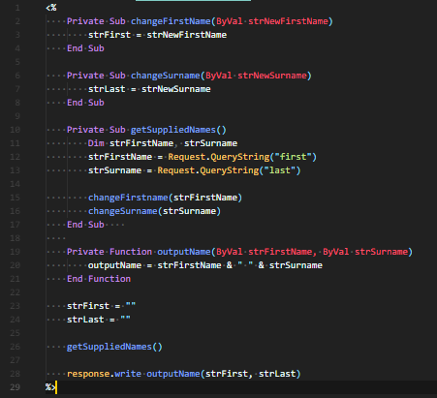
Debugging Code
Request is:
http://test.com/name.asp?forename=Hayley&surname=Smith
Client is saying that their names are not being displayed correctly in the page.

Slide 33
Queries & Questions ?

